Slide 1
Automatic Lens Smear Detection
Geospatial Vision & Visualization
Goutam Raju [gmr4417], Lida Zhang [lzo3378], William Ehrich [wde220]

Slide 2
Approach to Problem
We can see that the smear remains almost constant in dimensions in all the pictures from any camera feed.
The background however, changes constantly.
Applying edge detection would thus result in detection of a large number of edges outside of the smear area.
Aggregating all the edges detected for the 4240 images would produce a solid foreground while leaving the lens smear section blank.
By doing this we can isolate the smear portion of the image.

Slide 3
Method Overview
Convert input image to grayscale
Apply Canny Edge Detector to image.
Add the resulting image matrix to the edge detected image matrix of next image and so on.
Continue till all images have been aggregated.
Convert aggregated image matrix to binary image.
Complement the aggregated image.
Perform Closing on the image to fill holes in the lens smear shapes.

Slide 4
Edge Detection
We convert the image to grayscale so we don’t have to deal with multiple color channels and to make edge detection easier.
Since the lens smear is a solid block in every camera feed, edge detection allows us to isolate the smear.
The remainder of the image is split into countless edges which cover most of the image.
Canny Edge detector has been used here to detect greater number of edges in non-smear parts of the image.

Slide 5
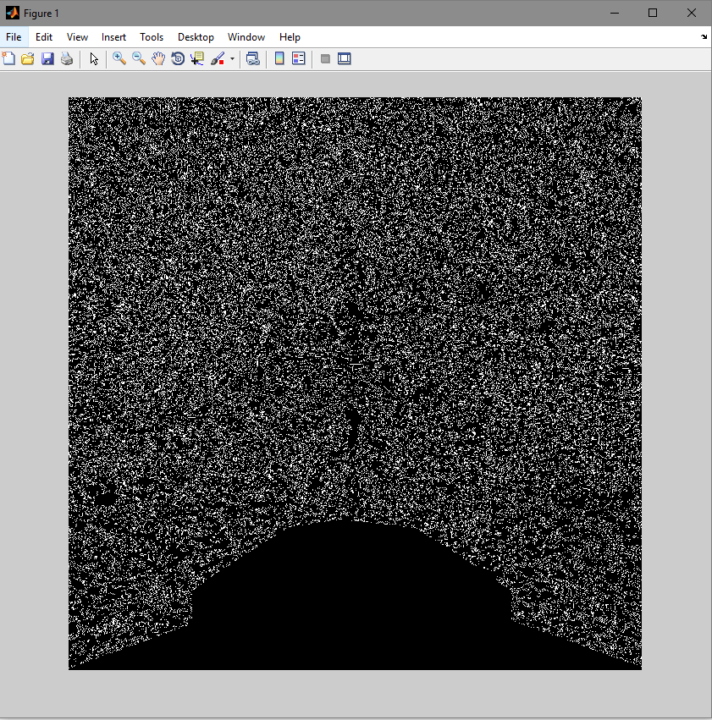
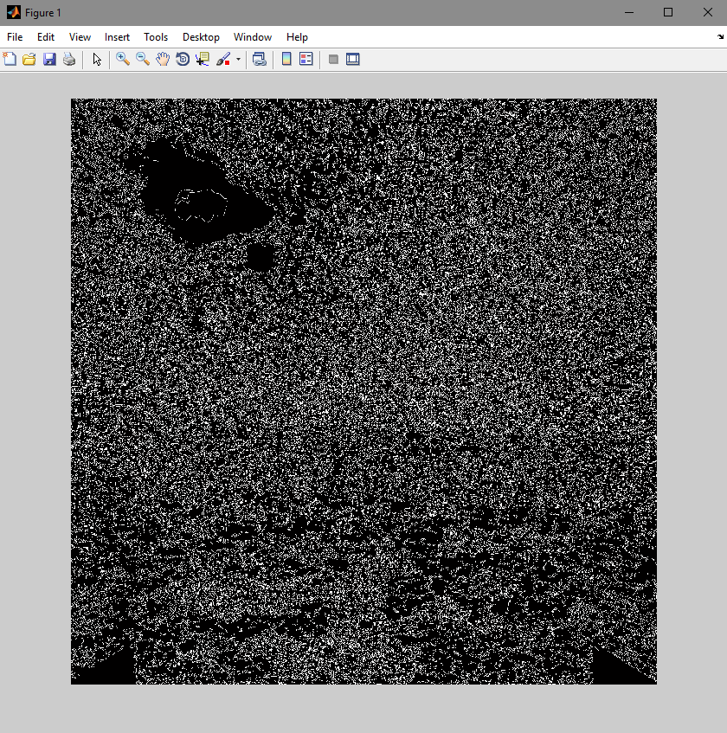
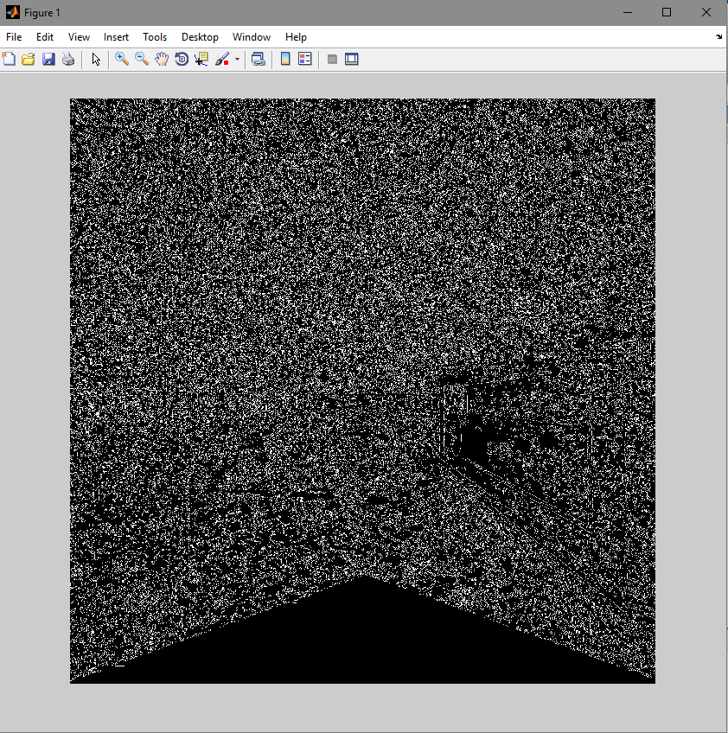
Edge detection [Intermediate Result]
Edge detection for image from camera 0
Edge detection for image from camera 1
Edge detection for image from camera 2

Slide 6
Image Aggregation
To get a more accurate representation of the lens smear we perform edge detection on all the images and add the resulting image matrices.
Since the lens smear portion does not have any lines within it, we know that no edges will be detected there.
The countless edges detected in other parts of the images will combine to form an almost solid block.
By doing this, we successfully isolate the lens smear from the background.

Slide 7
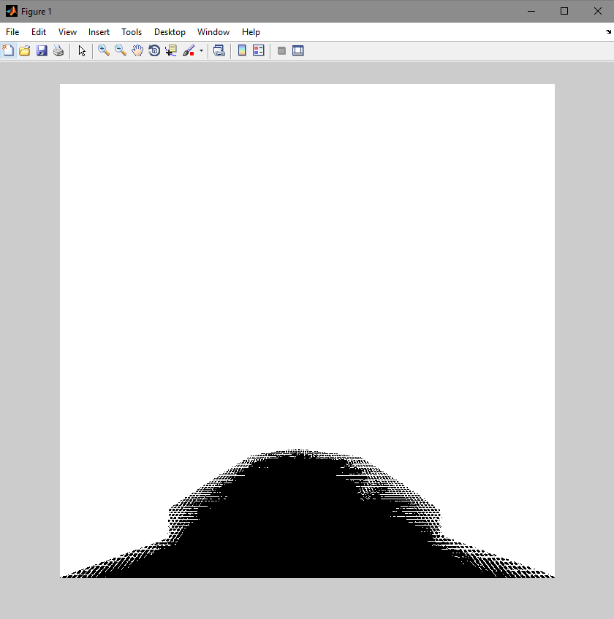
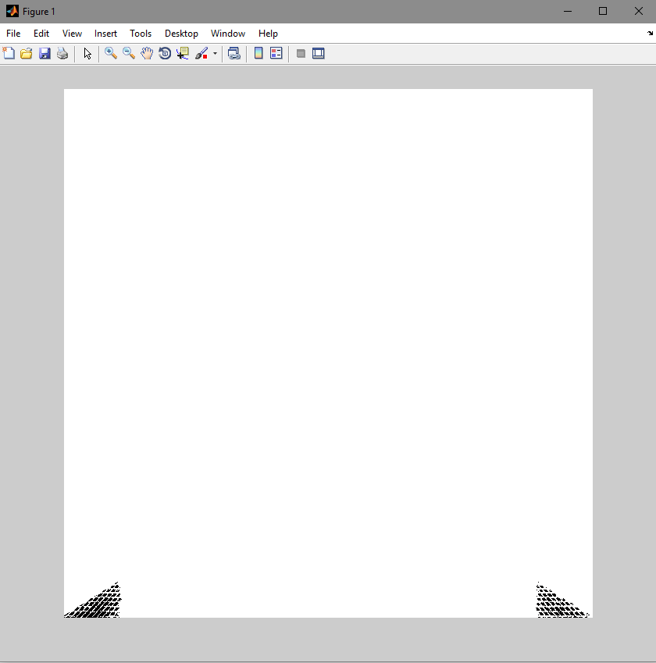
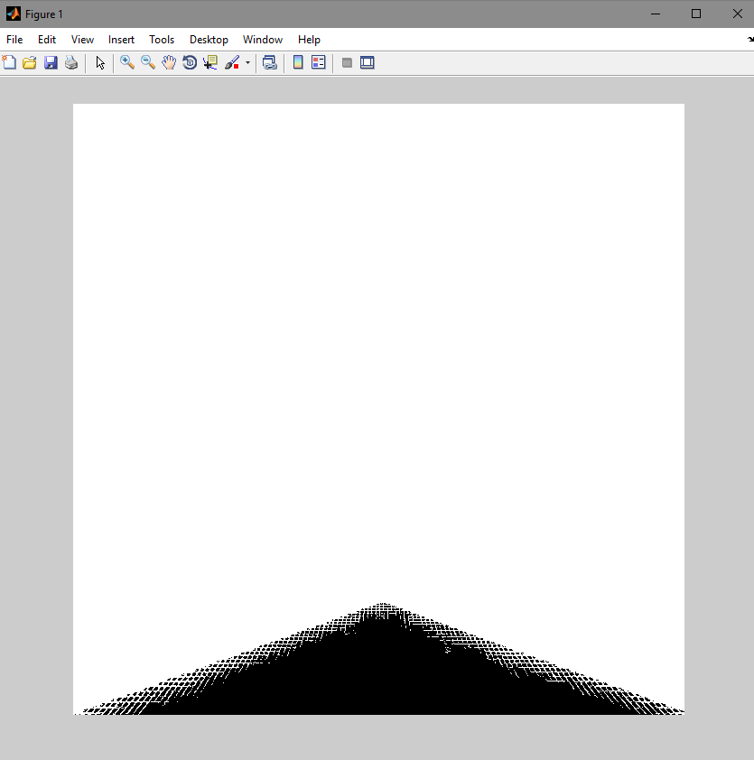
Image Aggregation [Intermediate Result]
Camera 0
Camera 1
Camera 2

Slide 8
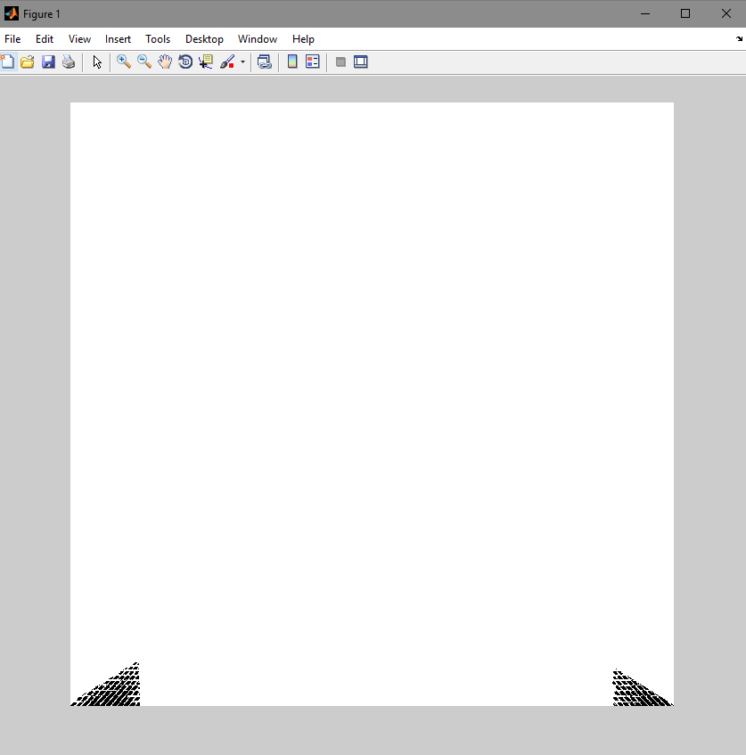

Image Aggregation [Intermediate Result]
Camera 5 [This camera has no noticeable lens smear]
Camera 3

Slide 9
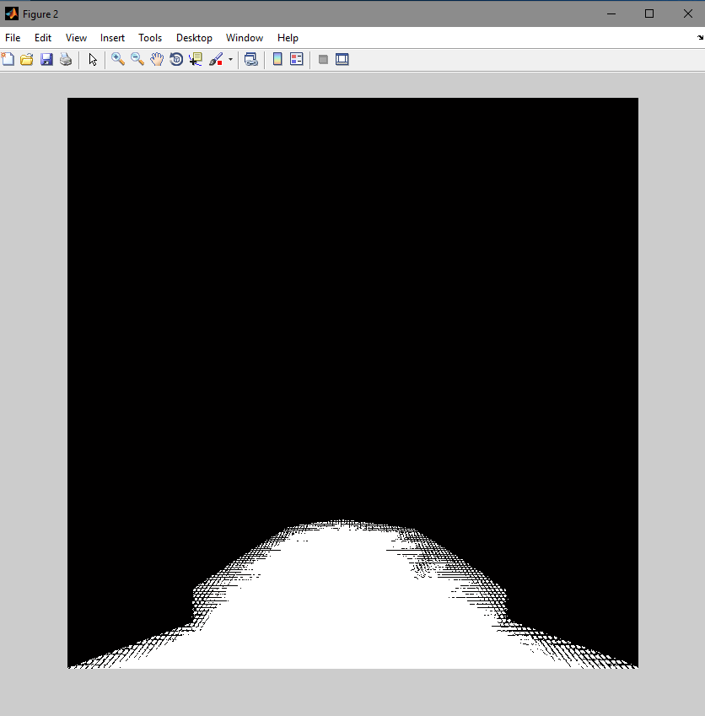
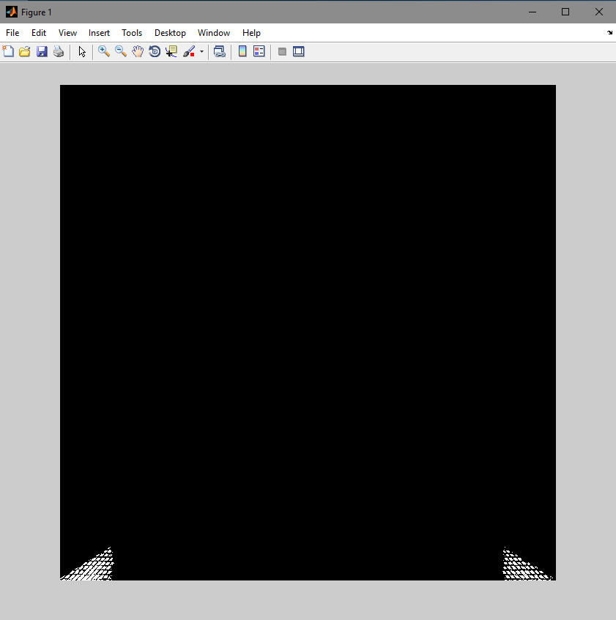
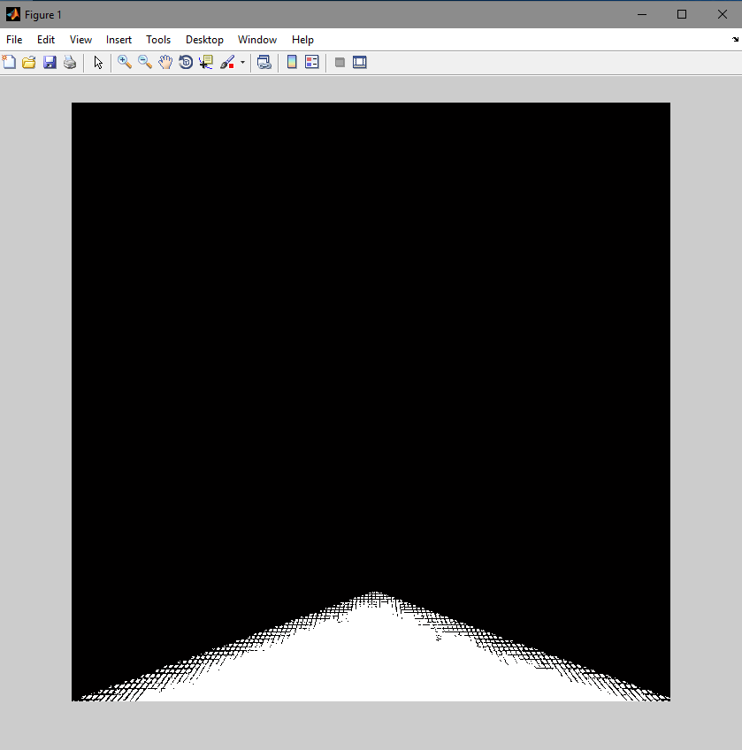
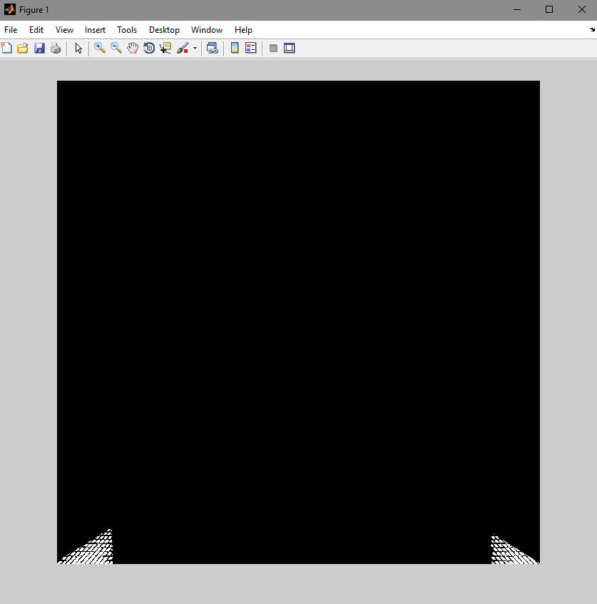
Image Complement
We convert the aggregated image to a binary image.
We then complement the image so that the lens smear is now the foreground.
Complemented images for Camera 0-3

Slide 10
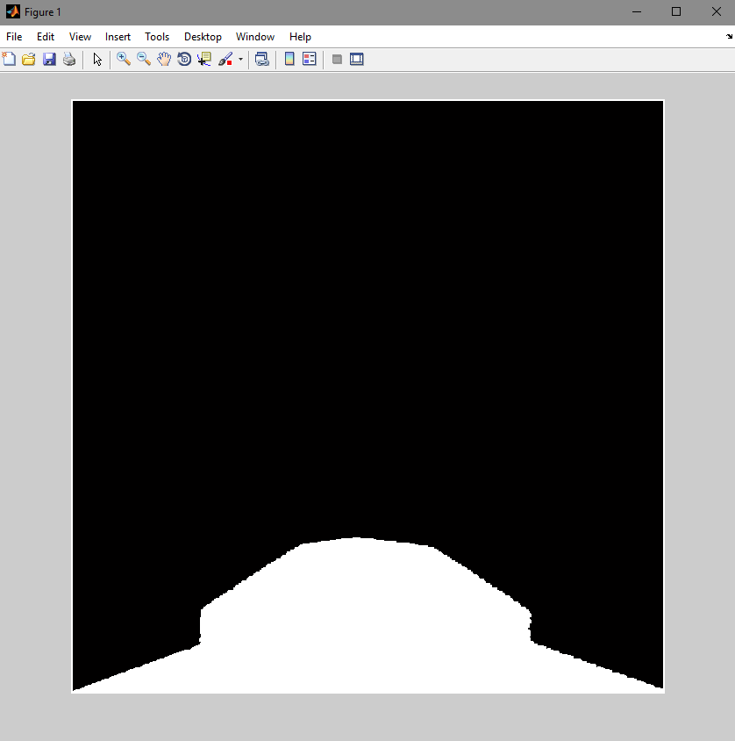
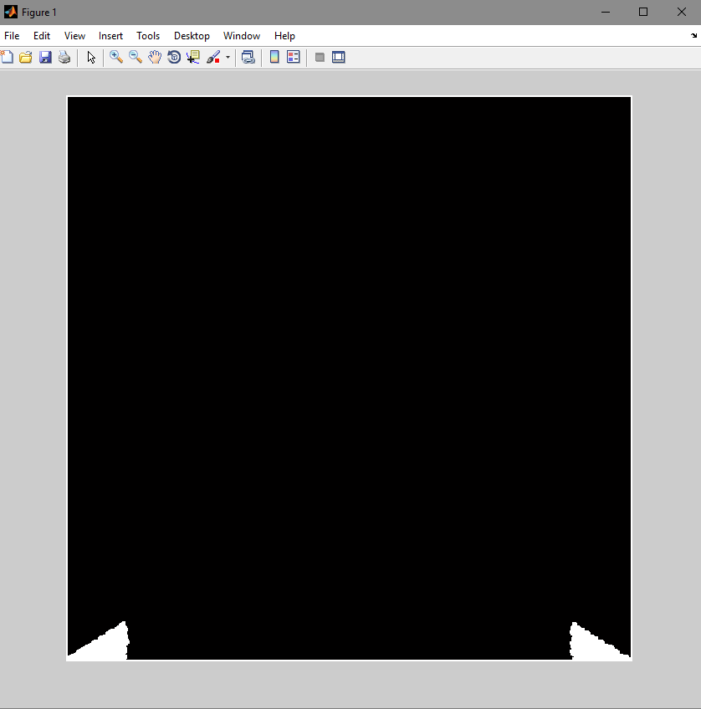
Morphological Operations
The final result has several holes in the lens smear mask.
We perform Closing (dilation followed by erosion) on the image to close these up.
This results in the final binary mask for the lens smears on each camera feed.
Camera 0 lens smear mask after dilating twice.
Camera 1 lens smear mask after dilating twice.

Slide 11
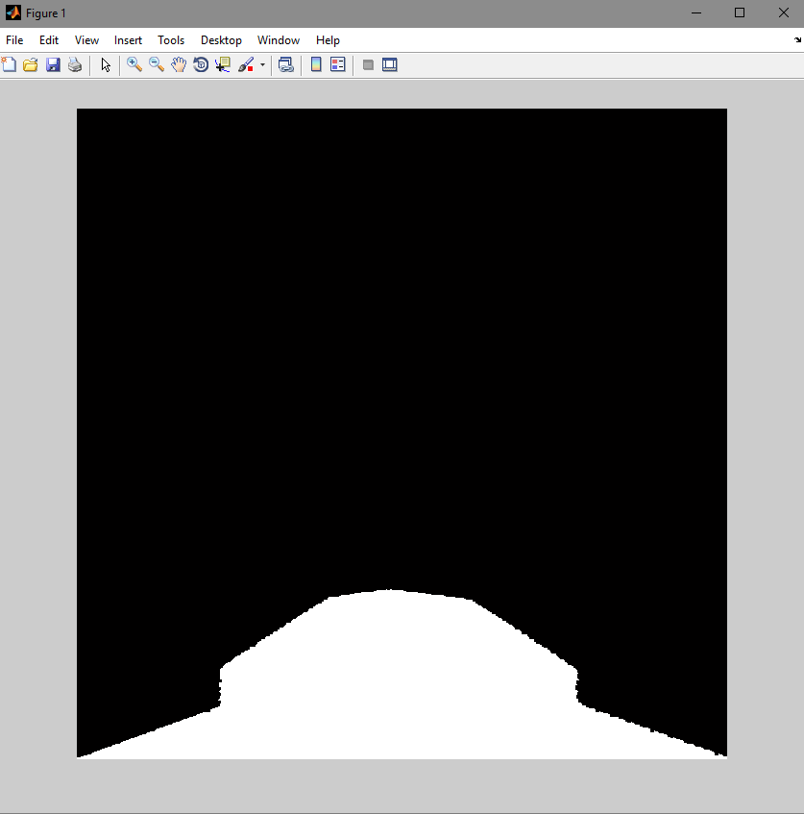
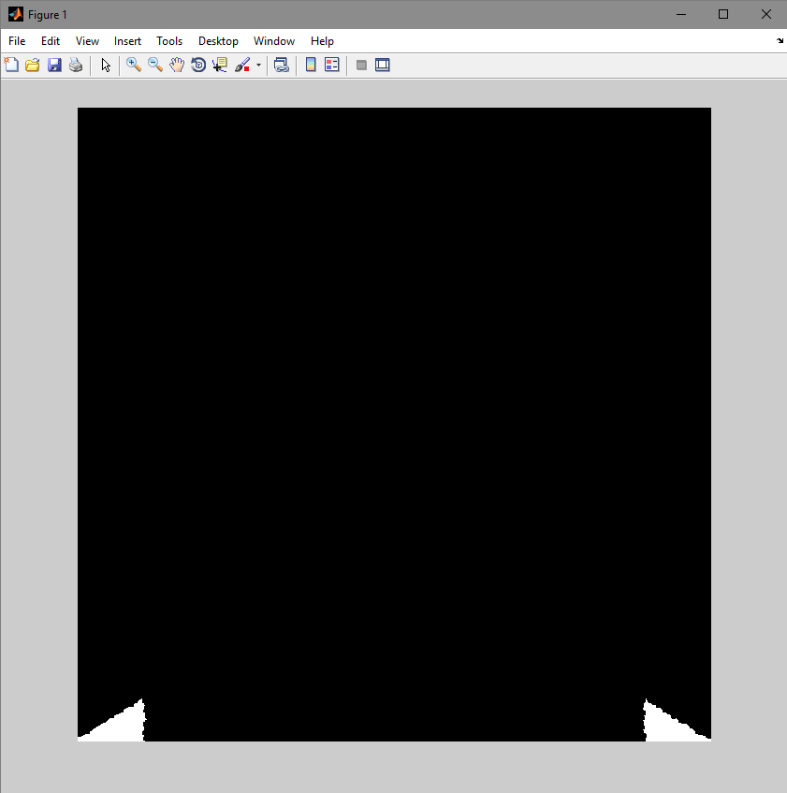
Final Output
Camera 0
Camera 1

Slide 12
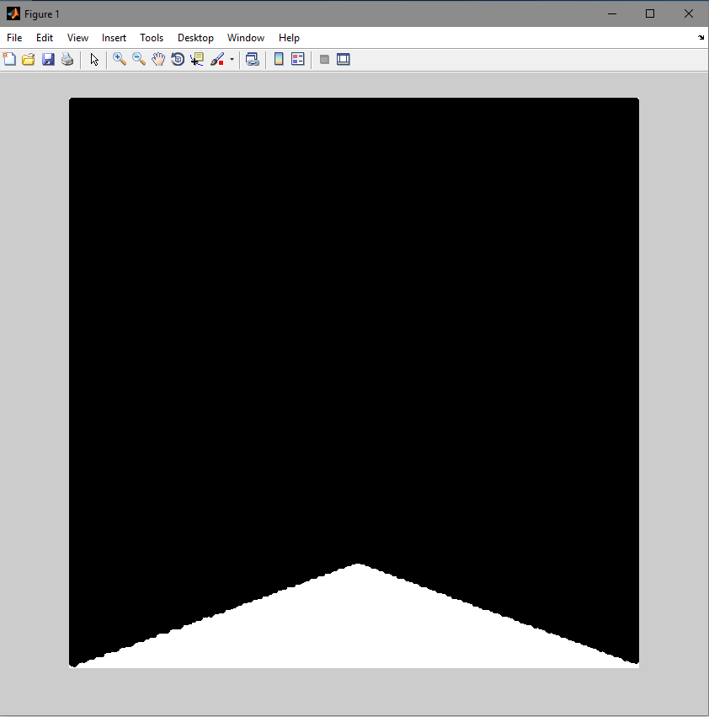
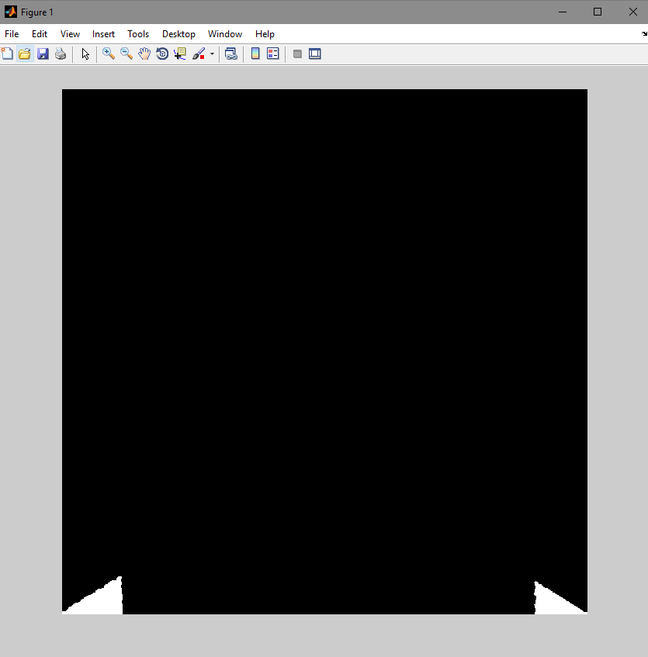
Final Output (Cont.)
Camera 2
Camera 4

Slide 13
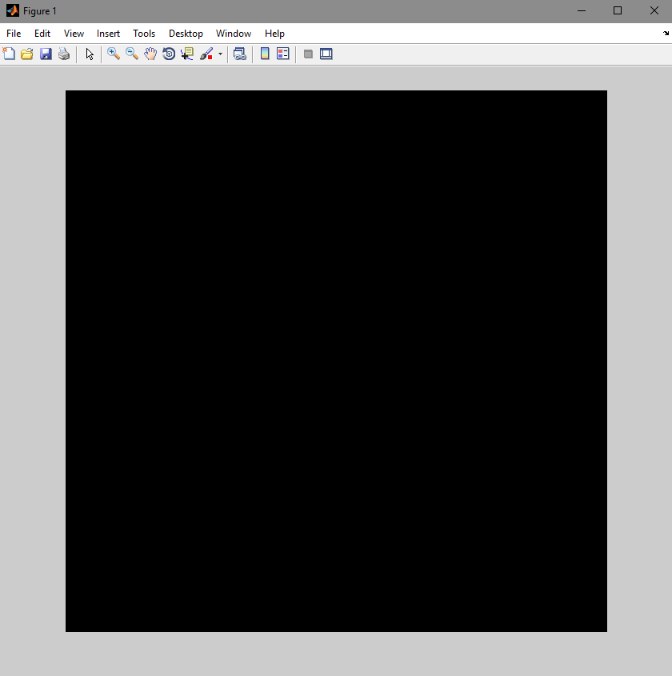
Final Output (Cont.)
Camera 5

Slide 14
Other Attempted Methods
The method in the previous slides gave the best result. However we also tried a different method which gave less desirable results.
The idea was based on the hypothesis that the smear did not change much in subsequent images.
Idea:
Create an empty ‘voting’ matrix with the same dimensions as the images.
Compare each corresponding pixel in 2 consecutive images from a feed.
If the difference is greater than a manually set threshold, increment the value for that pixel in the voting matrix.

Slide 15
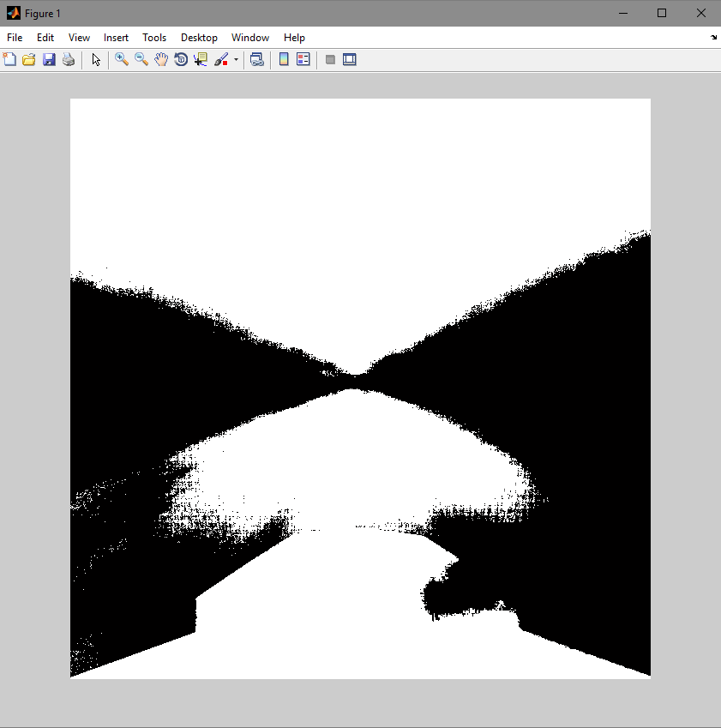
Other Attempted Methods (Cont.)
Repeat for all images.
If the value of a pixel in the voting matrix is greater than a set threshold, it is deemed to be a lens smear pixel.
Output for camera 0:
The smear is detected, however large amounts of the background also remain. (Mostly due to somewhat uniform color of the sky). Desirable results could not be achieved with this method.

